Slide 1

Video-Based Emotion Recognition Using Generative AI Models

Slide 2
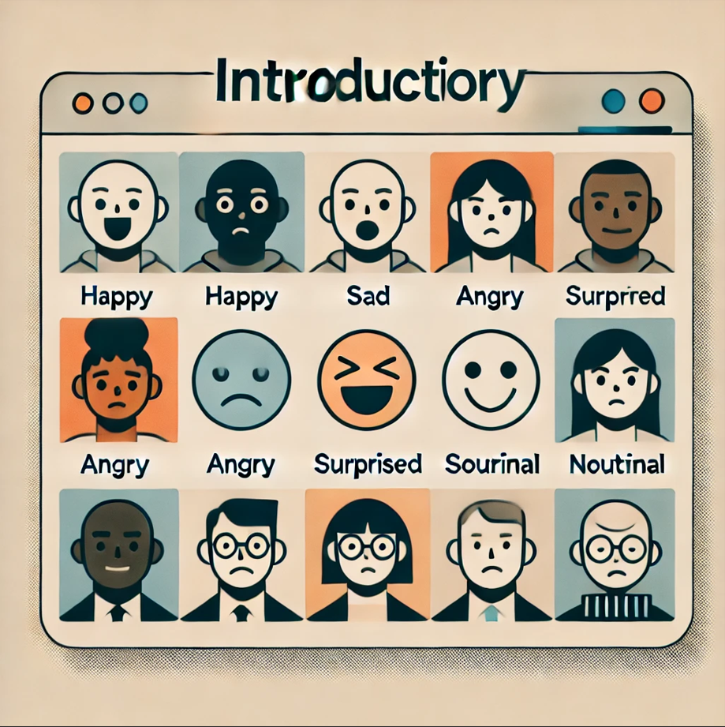
Facial expression recognition is a key area in human-computer interaction. It leverages advancements in AI to interpret human emotions through facial features, bridging the gap between technology and emotional intelligence.
INTRODUCTION

Slide 3
PROBLEM STATEMENT
Despite significant advancements in AI, recognizing subtle emotions is still challenging. Issues like Barriers, varying lighting conditions, and diversity in human expressions create barriers to accurate emotion detection using vae and gan models.

Slide 4
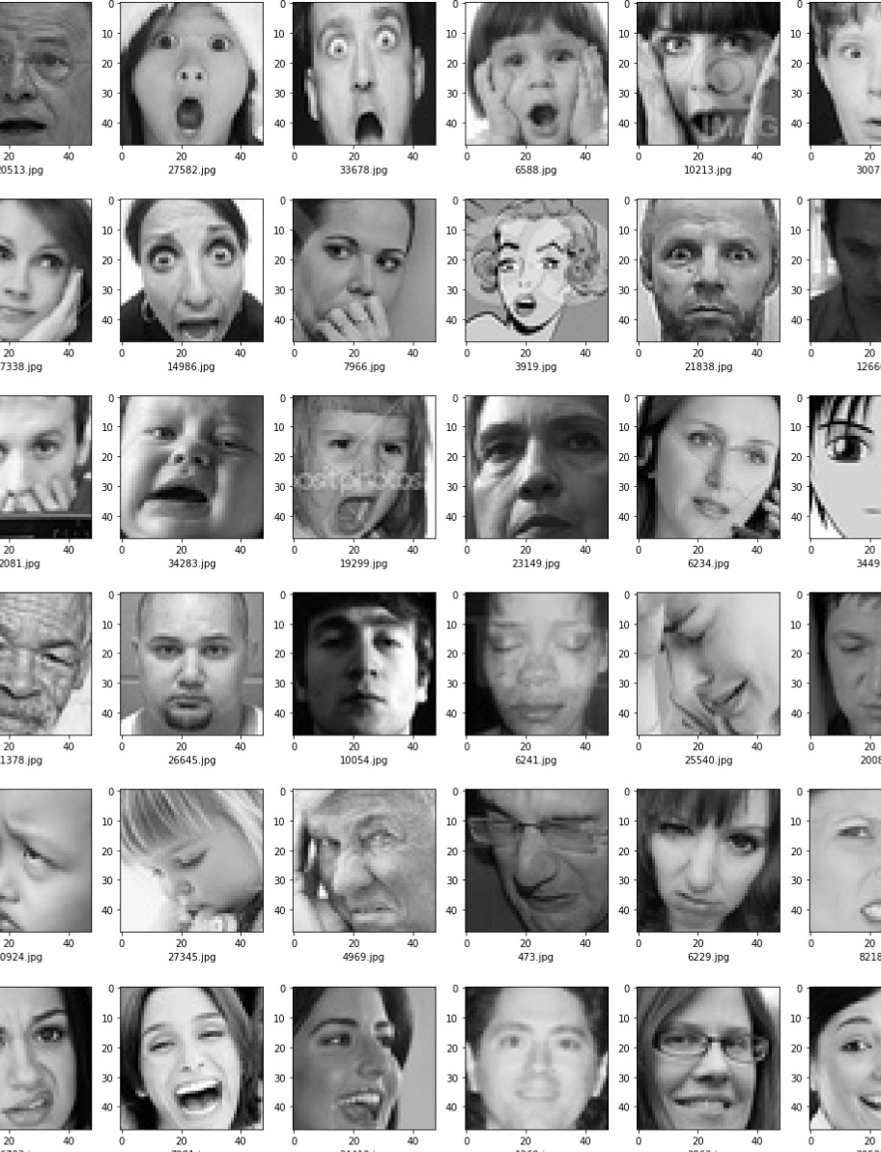
Objectives
Create a system to classify emotions accurately from facial images.
Improve the model's reliability across diverse datasets and scenarios.
Use GANs and VAEs to handle variations and enhance training data.

Slide 5
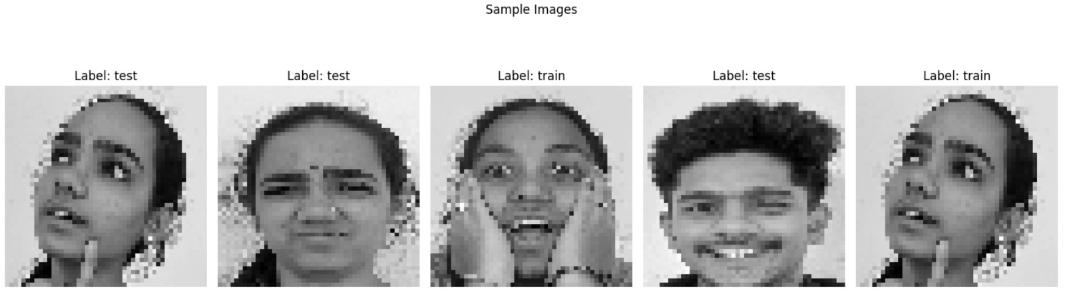
METHODOLOGY
CNN extracts features to classify emotions from facial images.
GAN generates realistic data to improve model performance.
VAE reduces noise and captures critical features for better predictions.
WebCam is used to recognize real-time emotion.

Slide 6
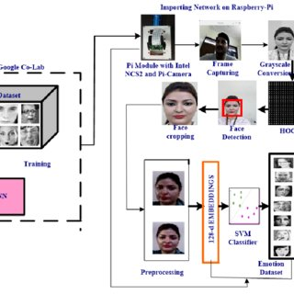
Dataset:
The dataset includes thousands of labeled face images with emotions.
It contains diverse expressions, lighting, and cultural representations.
Data preprocessing ensures quality and diversity for robust training.
We’ve used our own images and we trained those face images for the facial recognition and used WebCam.
References:
https://www.kaggle.com/datasets/jonathanoheix/face-expression-recognition-dataset

Slide 7

Training the Dataset
Training is the process of teaching a machine learning model to recognize patterns in data. During training, the model learns by adjusting its parameters (weights and biases) to minimize the difference between its predictions and the actual labels in the dataset.
Testing the Dataset
Testing is the process of evaluating the trained model's performance on unseen data. The testing dataset is separate from the training data and is used to check how well the model generalizes to new inputs. It helps assess the accuracy, precision, recall, and other metrics of the model.

Slide 8
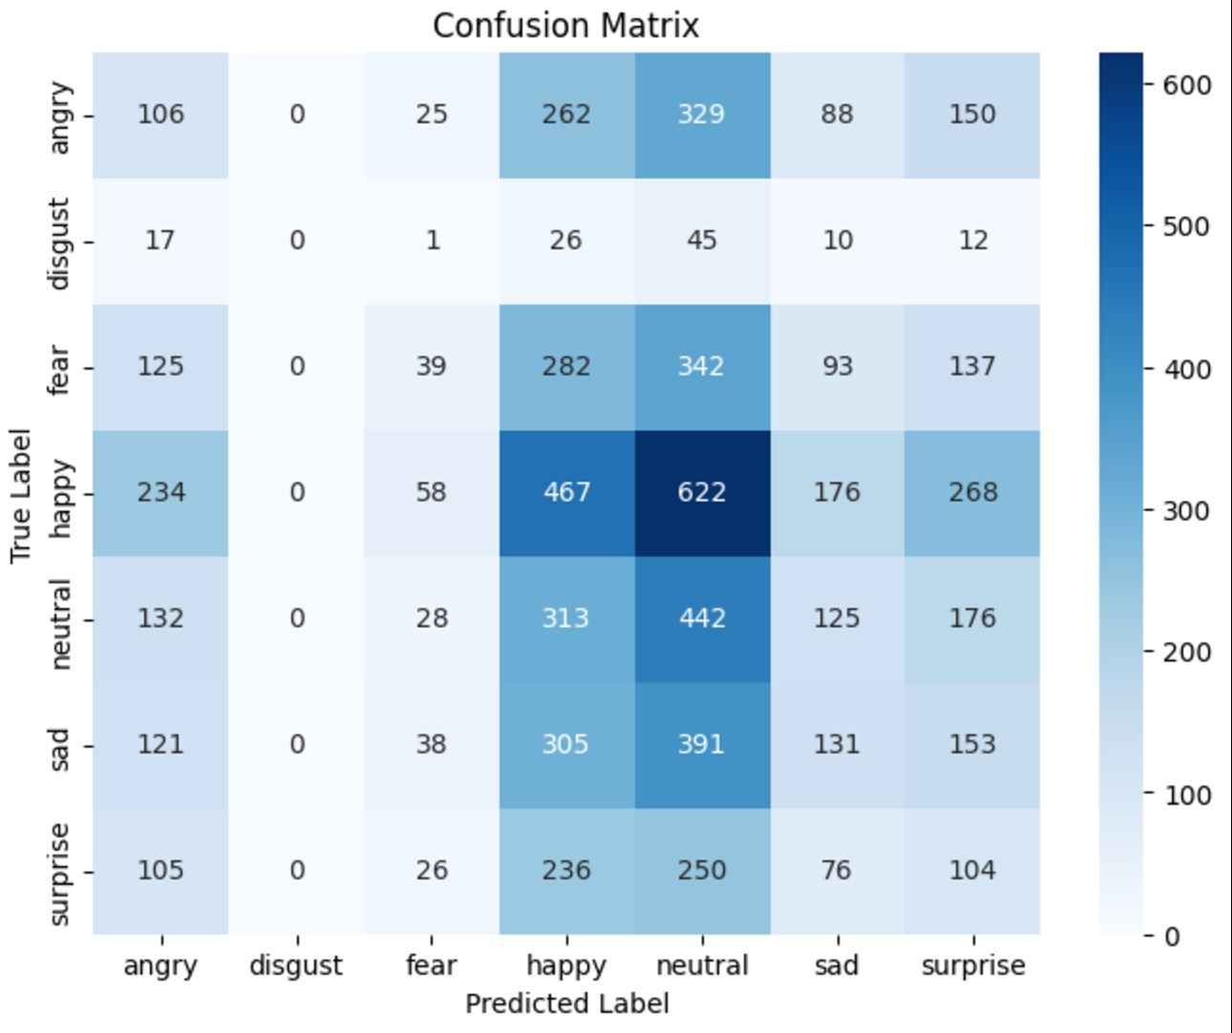
Confusion Matrix
A confusion matrix is a table used to evaluate the performance of a classification model. It compares the model's predictions with the actual labels and shows how many predictions were correct and incorrect for each class. It helps calculate metrics like accuracy, precision, recall, and F1-score.
Each row of the matrix represents the instances of an actual class, while each column represents the instances of a predicted class. Metrics like accuracy, precision, recall, and F1-score can be derived from the confusion matrix to provide further insights into model performance.

Slide 9
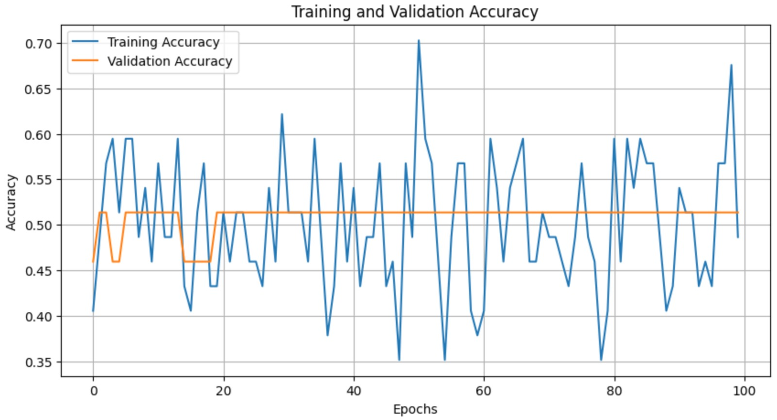
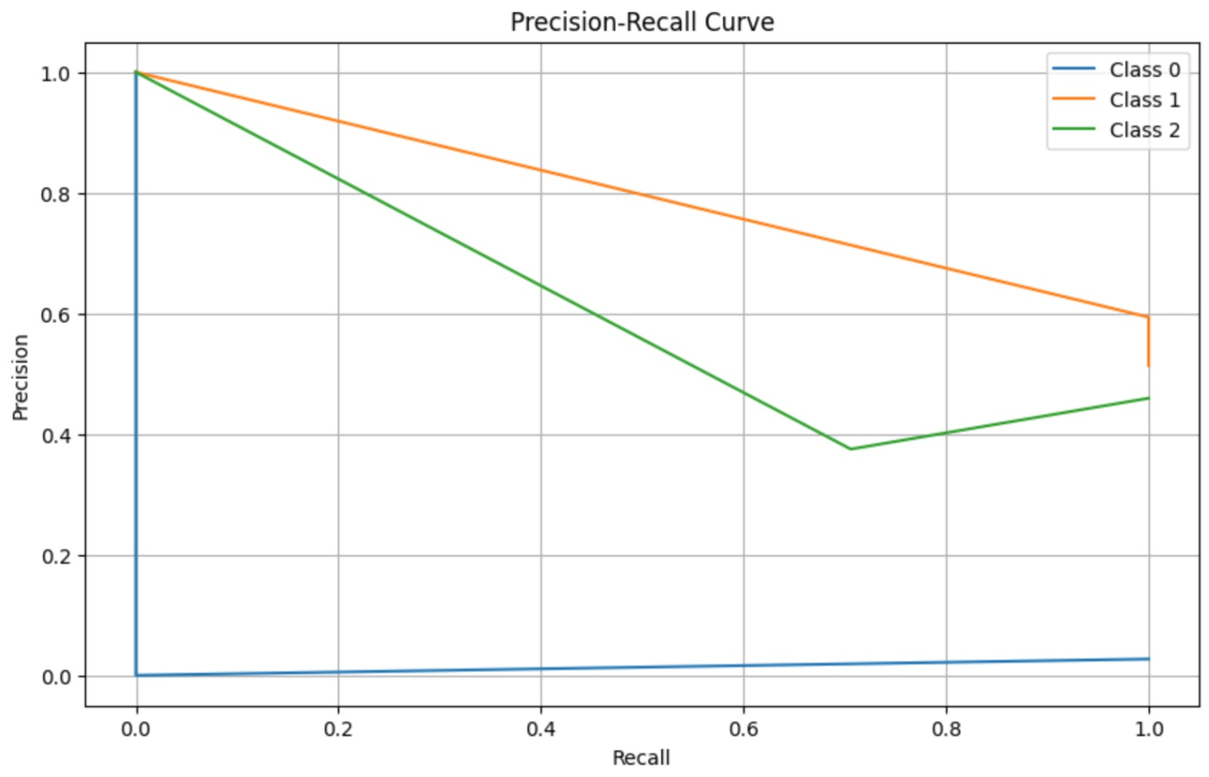
CNN
A Convolutional Neural Network (CNN) is a type of deep learning model designed for processing structured data like images. It automatically detects and learns patterns (like edges, textures, and shapes) by applying filters to the input data, making it highly effective for tasks such as image classification, object detection, and facial recognition.
The CNN graph is a powerful tool for understanding how data is processed, features are learned, and predictions are made, particularly in tasks like facial expression detection.

Slide 10

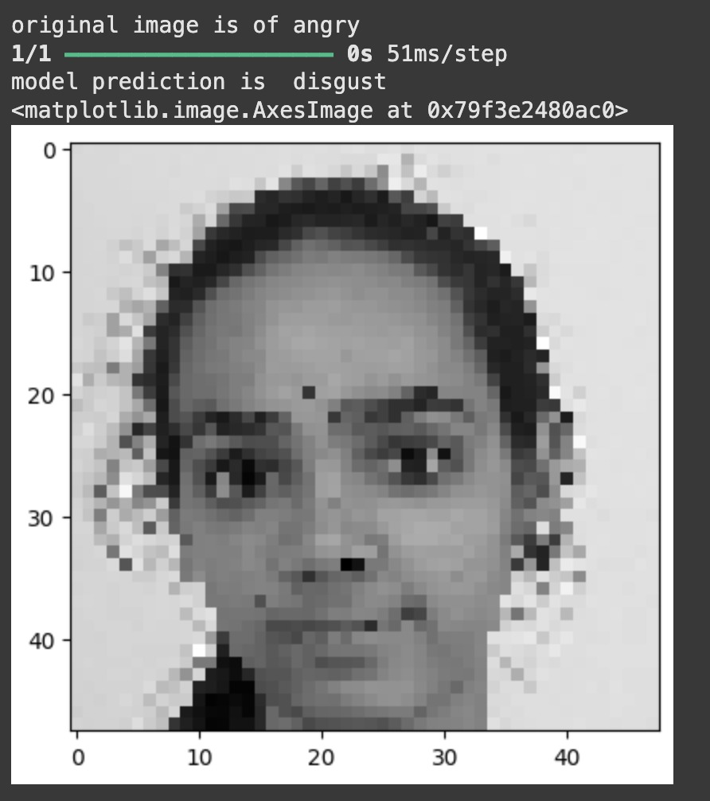
Results & Analysis:
The model performs well in classifying emotions accurately.
Metrics like accuracy and confusion matrices highlight strengths and gaps.
GAN and VAE improved data quality and overall results.

Slide 11
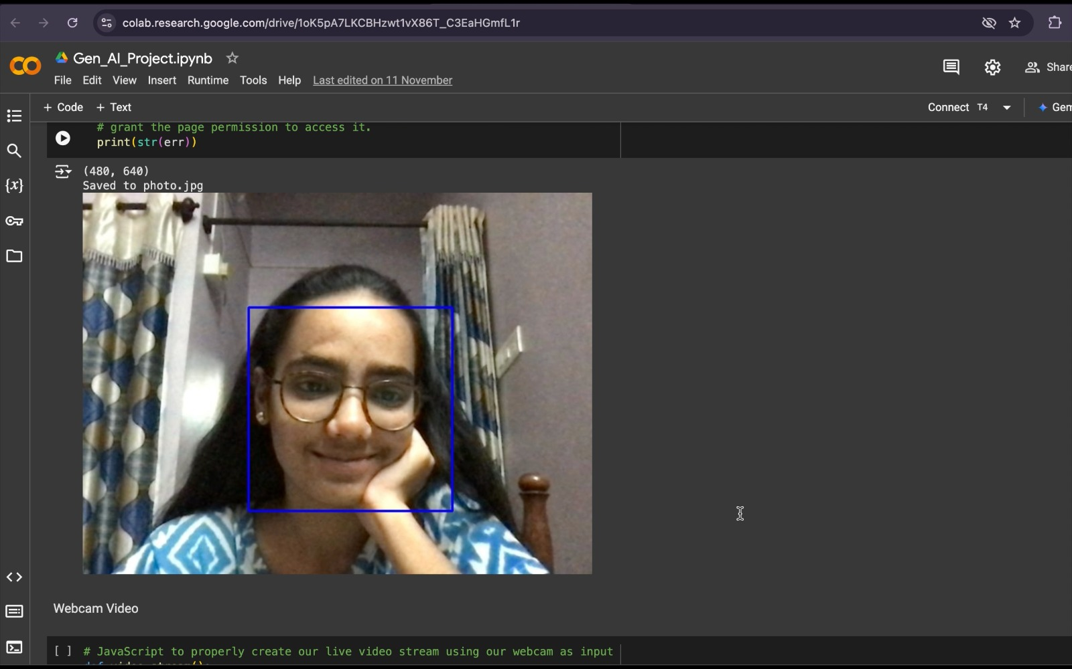
Emotion Recognition Using WebCam
happy

Slide 12

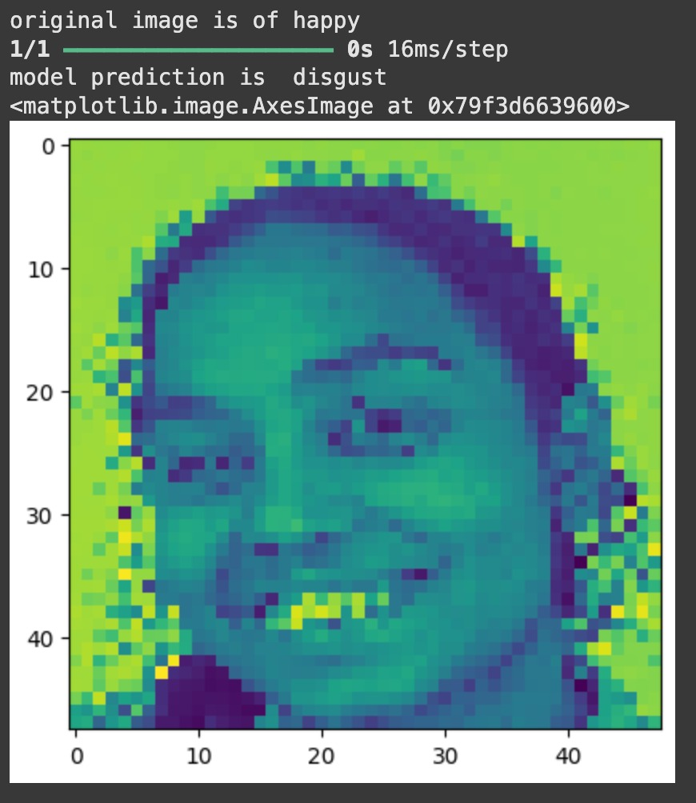
Conclusion & Future Work
The project succeeded in building a reliable emotion recognition system.
Future plans include real-time detection and expanding to more emotions.
Improvements aim to make the system faster and more inclusive.

Slide 13
Thank you
V. Divya -2203A52130
G. Sai Krishna Priya -2203A52085
K. Deepak -2303A51LB6
P. Siddharth Rao -2203A52115
N. Dhanush -2203A52113

